Slide 1
React Components
Lecturer: Ngo Huy Bien
Software Engineering Department
Faculty of Information Technology
VNUHCM - University of Science
Ho Chi Minh City, Vietnam
nhbien@fit.hcmus.edu.vn

Slide 2

Objectives

Slide 3

Contents

Slide 4

References
Morten Barklund and Azat Mardan (2023). React Quickly. Manning.
Kirupa Chinnathambi (2018). Learning React: A Hands-On Guide to Building Web Applications Using React and Redux. Addison-Wesley Professional.

Slide 5
Why Do We Use JSX? [1]
JSX is a JavaScript extension that provides syntactic sugar (i.e., making it easier to type, but otherwise functionally equivalent) for function calls and object construction, particularly a replacement for React.createElement().
JSX produces React elements while allowing you to harness the full power of JavaScript.
...
const myUI =
<div>
<h1>Batman</h1>
<h1>Iron Man</h1>
<h1>Nicolas Cage</h1>
<h1>Mega Man</h1>
</div>;
ReactDOM.render(
myUI, destination
);
...

Slide 6
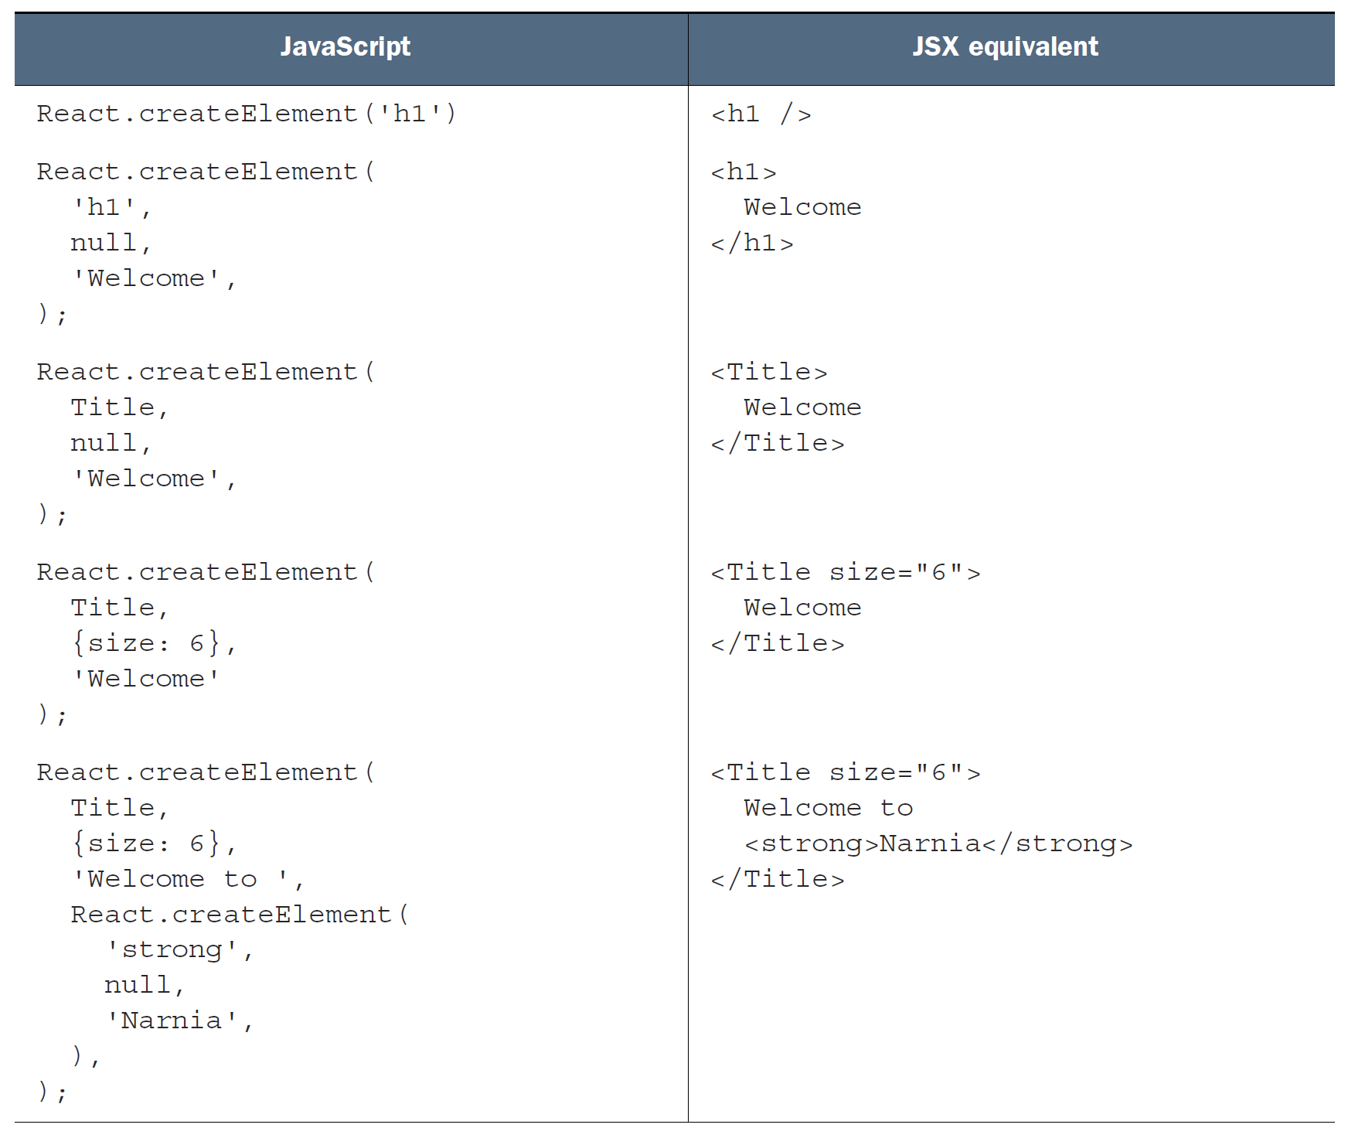
JavaScript Code versus JSX

Slide 7
A Quick Review of Functions [2]
This capability to have functions call other functions enables us to cleanly separate what functions do.
You don't need to have one monolithic function that does everything under the sun.
You can distribute the functionality across many functions specialized for a particular type of task.
function formatDistance(distance) {
return distance + "km";
}
function getDistance(speed, time) {
var result = speed * time;
alert(formatDistance(result));
}
getDistance(42, 21);

Slide 8
1. Create Function Component
npm init react-app hello-functional-component
function Heading() {
return (
<h1>This is an h1 heading.</h1>
)
}
function App() {
return (
<Heading />
);
}
export default App;

Slide 9
2. Create Class Component
<body>
<div id="container"></div>
<script type="text/babel">
class HelloWorld extends React.Component {
render() {
return (
<h1>Hello, componentized world!</h1>
)
}
}
var destination = document.querySelector("#container");
ReactDOM.render(
<HelloWorld />,
destination
);
</script>
</body>

Slide 10
props
React components use props to communicate with each other.
Every parent component can pass some information to its child components by giving them props.

Slide 11

3. Set Component Properties
<body>
<div id="container"></div>
<script type="text/babel">
class HelloWorld extends React.Component {
render() {
return (
<h1>Hello, {this.props.greetTarget}!</h1>
)
}
}
var destination = document.querySelector("#container");
ReactDOM.render(
<HelloWorld greetTarget="Property" />,
destination
);
</script>
</body>
In JSX, if you want something to get evaluated as an expression, you need to wrap that something inside curly brackets.

Slide 12
props.children
In JSX expressions, the content between an opening and closing tag is passed as a unique prop called children.
Why use props.children? Some components don't know their children ahead of time.

Slide 13

4. Access Component Children
<body>
<div id="container"></div>
<script type="text/babel">
class Buttonify extends React.Component {
render() {
return (
<div>
<button type={this.props.behavior}>
{this.props.children}
</button>
</div>
)
}
}
var destination = document.querySelector("#container");
ReactDOM.render(
<Buttonify behavior="Submit">SEND DATA</Buttonify>,
destination
);
</script>
</body>

Slide 14
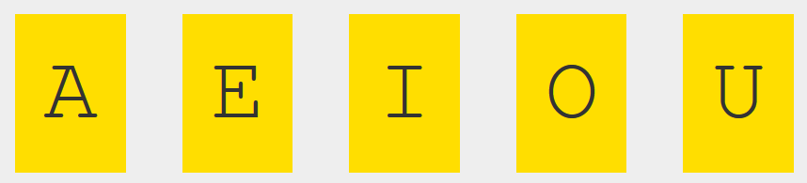
5. Use Children for Styling
<body>
<div id="container"></div>
<script type="text/babel">
class Letter extends React.Component {
render() {
return (
<div className="letter">
{this.props.children}
</div>
)
}
}
var destination = document.querySelector("#container");
ReactDOM.render(
<div>
<Letter>A</Letter>
<Letter>E</Letter>
...

Slide 15
6. Create Style as Object
...
class Letter extends React.Component {
render() {
var letterStyle = {
padding: 10,
margin: 10,
backgroundColor: "#ffde00",
color: "#333",
display: "inline-block",
fontFamily: "monospace",
fontSize: 32,
textAlign: "center"
};
return (
<div style={letterStyle}>
{this.props.children}
</div>
);
}
}
...

Slide 16

7. Set Style Object Property
...
<script type="text/babel">
class Letter extends React.Component {
render() {
var letterStyle = {
...
backgroundColor: this.props.bgcolor,
color: "#333",
...
ReactDOM.render(
<div>
<Letter bgcolor="#58B3FF">A</Letter>
<Letter bgcolor="#FF605F">E</Letter>
<Letter bgcolor="#FFD52E">I</Letter>
<Letter bgcolor="#49DD8E">O</Letter>
<Letter bgcolor="#AE99FF">U</Letter>
</div>,
destination
);
...

Slide 17
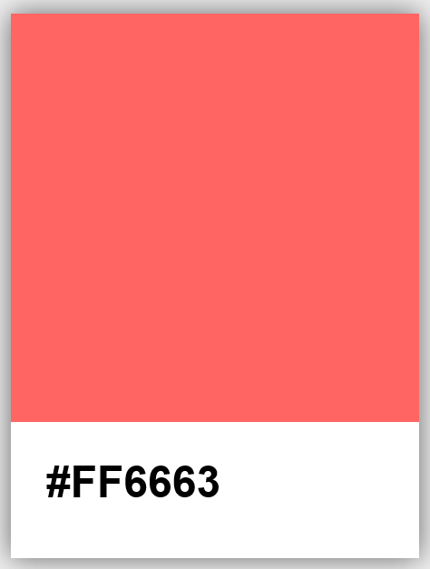
8. Create Nested Components
class Card extends React.Component {
...
return (
<div style={cardStyle}>
<Square color={this.props.color} />
<Label color={this.props.color} />
</div>
);
}
});
var destination = document.querySelector("#container");
ReactDOM.render(
<div>
<Card color="#FF6663" />
</div>,
destination
);

Slide 18


Slide 19
Props and State
State and props are both plain JavaScript or JS objects that React uses to hold information.
If a component needs to alter one of its attributes at some point in time, that attribute should be part of its state, otherwise, it should be a prop for that component.
State is managed within the component, whereas props get passed to the component.

Slide 20
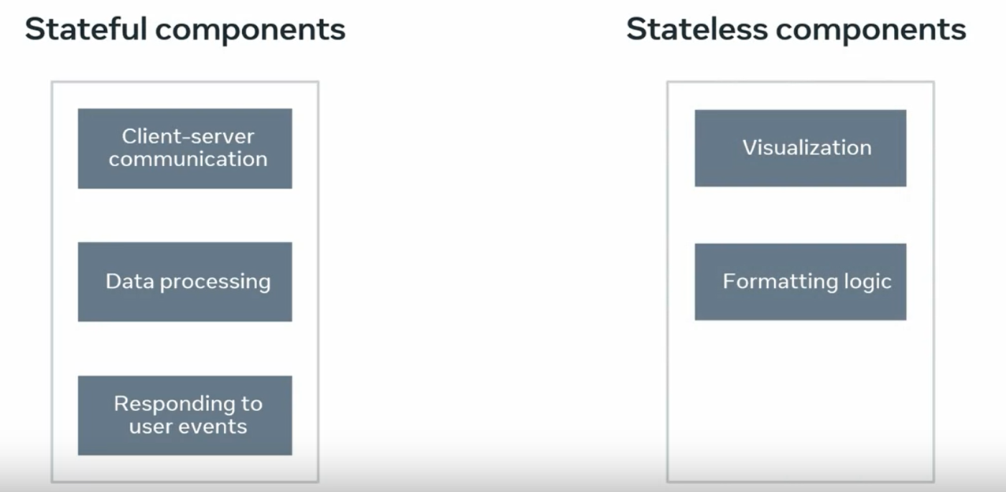
Stateless vs. Stateful Components
Stateless components: props only, no state.
Stateless components: props and state.

Slide 21

State
class LightningCounter extends React.Component {
constructor(props) {
super(props);
this.state = {
strikes: 0
};
this.timerTick = this.timerTick.bind(this);
{/* explicitly bind our timerTick function to our component
so that all the this references resolve properly. */}
}
timerTick() {
this.setState({
strikes: this.state.strikes + 100
});
}
componentDidMount() {
setInterval(this.timerTick, 1000);
}
render() {
var counterStyle = {
...
var count = this.state.strikes.toLocaleString();
return (
<h1 style={counterStyle}>{count}</h1>
...

Slide 22
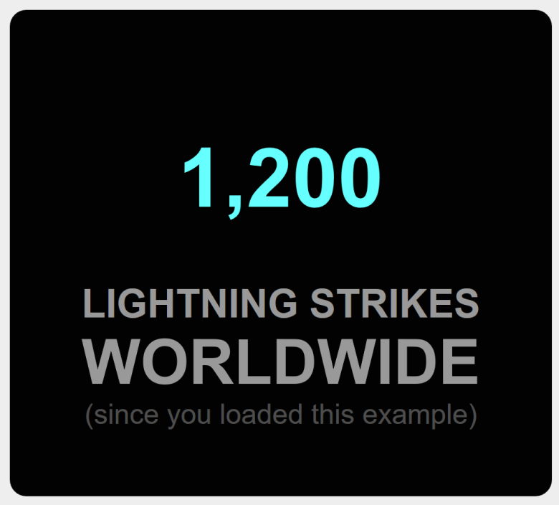
Transferring Styles
class LightningCounterDisplay extends React.Component {
render() {
var commonStyle = {
margin: 0,
padding: 0
}
var divStyle = {
width: 250,
...
};
var textStyles = {
emphasis: {
fontSize: 38,
...commonStyle
},
smallEmphasis: {
...commonStyle
},
small: {
fontSize: 17,
opacity: 0.5,
...commonStyle
}
}
return(
<div style={divStyle}>
<LightningCounter />
<h2 style={textStyles.smallEmphasis}>LIGHTNING STRIKES</h2>
<h2 style={textStyles.emphasis}>WORLDWIDE</h2>
<p style={textStyles.small}>(since you loaded this example)</p>
</div>
);
...

Slide 23

JSX Variable
class Circle extends React.Component {
render() {
var circleStyle = {
...
borderRadius: "50%",
width: 100,
height: 100,
};
return (
<div style={circleStyle}>
</div>
);
}
}
var destination = document.querySelector("#container");
var theCircle = <Circle bgColor="#F9C240"/>;
ReactDOM.render(
<div>
{theCircle}
</div>,
destination
);
The theCircle variable stores the JSX for instantiating our Circle component.
Why doing this?

Slide 24

JSX Function
...
function showCircle() {
var colors = ["#393E41", "#E94F37", "#1C89BF", "#A1D363"];
var ran = Math.floor(Math.random() * colors.length);
// return a Circle with a randomly chosen color
return <Circle bgColor={colors[ran]} />;
};
var destination = document.querySelector("#container");
ReactDOM.render(
<div>
{showCircle()}
</div>,
destination
);
...

Slide 25
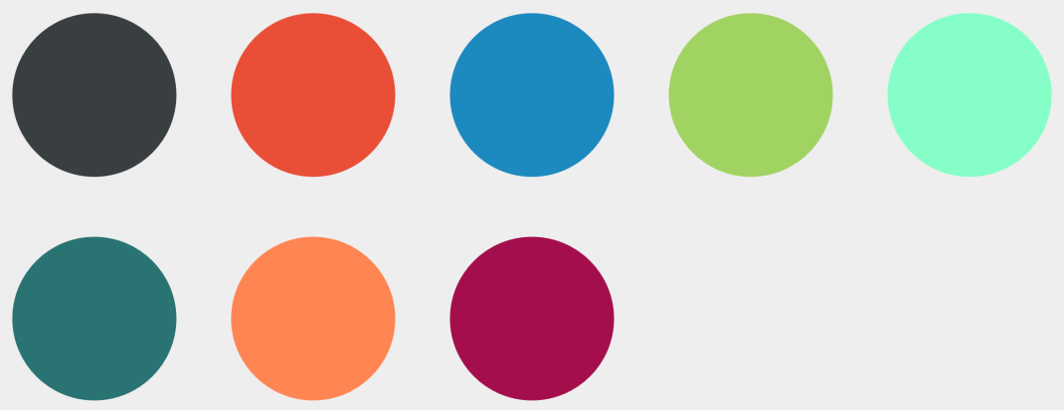
JSX Array
...
var colors = ["#393E41", "#E94F37", "#1C89BF", "#A1D363",
"#85FFC7", "#297373", "#FF8552", "#A40E4C"];
var renderData = [];
for (var i = 0; i < colors.length; i++) {
renderData.push(<Circle bgColor={colors[i]}/>);
}
var destination = document.querySelector("#container");
ReactDOM.render(
<div>
{renderData}
</div>,
destination
);
...

Slide 26
Keys
https://react.dev/learn/rendering-lists
Keys tell React which array item each component corresponds to, so that it can match them up later.
This becomes important if your array items can move (e.g. due to sorting), get inserted, or get deleted.
A well-chosen key helps React infer what exactly has happened, and make the correct updates to the DOM tree.
You need to give each array item a key — a string or a number that uniquely identifies it among other items in that array:
<li key={person.id}>...</li>

Slide 27
Where to Get Your Key
Data from a database: If your data is coming from a database, you can use the database keys/IDs, which are unique by nature.
Locally generated data: If your data is generated and persisted locally (e.g. notes in a note-taking app), use an incrementing counter, crypto.randomUUID() or a package like uuid when creating items.
Although item indexes can be used as keys, using indexes as keys can create problems if the order of your list of items is prone to change and can negatively affect performance.

Slide 28
JSX Key
...
var colors = ["#393E41", "#E94F37", "#1C89BF", "#A1D363",
"#85FFC7", "#297373", "#FF8552", "#A40E4C"];
var renderData = [];
for (var i = 0; i < colors.length; i++) {
var color = colors[i];
renderData.push(<Circle key={i + color} bgColor={colors[i]}/>);
}
var destination = document.querySelector("#container");
ReactDOM.render(
<div>
{renderData}
</div>,
destination
);
...
Getting a unique identifier that React can then use to optimize any future UI updates.

Slide 29
JSX Underhood
...
var colors = ["#393E41", "#E94F37", "#1C89BF", "#A1D363",
"#85FFC7", "#297373", "#FF8552", "#A40E4C"];
var renderData = [];
for (var i = 0; i < colors.length; i++) {
var color = colors[i];
renderData.push(React.createElement(Circle,
{
key: i + color,
bgColor: color
}));
}
var destination = document.querySelector("#container");
ReactDOM.render(
<div>
{renderData}
</div>,
destination
);
...

Slide 31

React and Functional Programming

Slide 32

Object-Oriented Programming
<body>
<div id="container"></div>
<script type="text/babel">
class HelloWorld extends React.Component {
render() {
return (
<h1>Hello, OOP world!</h1>
)
}
}
var destination = document.querySelector("#container");
ReactDOM.render(
<HelloWorld />,
destination
);
</script>
</body>

Slide 33

Functional Programming
<body>
<div id="container"></div>
<script type="text/babel">
const HelloWorld = () => <h1>Hello, FP world!</h1>;
var destination = document.querySelector("#container");
ReactDOM.render(
<HelloWorld />,
destination
);
</script>
</body>

Slide 34

Passing Arguments
<body>
<div id="container"></div>
<script type="text/babel">
const HelloWorld = (props) => <h1>Hello, {props.name}!</h1>;
var destination = document.querySelector("#container");
ReactDOM.render(
<HelloWorld name = "Passing Arguments" />,
destination
);
</script>
</body>

Slide 35

Calling Functions
<body>
<div id="container"></div>
<script type="text/babel">
const HelloWorld = (props) => <h1>Hello, {props.name}!</h1>;
const App = () => { return HelloWorld({name: "Calling Function"}); }
var destination = document.querySelector("#container");
ReactDOM.render(
<App />,
destination
);
</script>
</body>

Slide 36
Unidirectional Data Flow with OOP
class App extends React.Component {
render() {
return (
<HelloWorld name="Unidirectional Data Flow with OOP" />)
}
}
class HelloWorld extends React.Component {
render() {
return (
<h1>Hello, {this.props.name}!</h1>)
}
}
var destination = document.querySelector("#container");
ReactDOM.render(
<App />,
destination
);

Slide 37
Unidirectional Data Flow with FP
const App = () => <HelloWorld name="Unidirectional Data Flow with FP" />;
const HelloWorld = (props) => <h1>Hello, {props.name}!</h1>;
var destination = document.querySelector("#container");
ReactDOM.render(
<App />,
destination
);

Slide 38

Composition
const HelloWorld = (props) => <h1>Hello, {props.name}!</h1>;
const HelloAndWelcome = (props) => <div><HelloWorld {...props} /><h2>Welcome to Functional Programming!</h2></div>;
const App = () => <HelloAndWelcome name="Composition" />;
var destination = document.querySelector("#container");
ReactDOM.render(
<App />,
destination
);

Slide 39

Higher-Order Functions
const HelloWorld = (props) => <h1>Hello, {props.name}!</h1>;
const AddWelcome = (GreetingComponent) => {
const TheNewComponent = (props) =>
<div><GreetingComponent {...props} /><h2>Welcome to High-Order Components!</h2></div>;
return TheNewComponent;
};
const App = () => { return AddWelcome(HelloWorld)({name : "High-Order Functions"}); }
var destination = document.querySelector("#container");
ReactDOM.render(
<App />,
destination
);

Slide 41
useState Hook
The useState hook’s return value in React is the array data structure.
The useState hook allows you to work with state in components.
When calling the useState() hook, the returned array holds the state variable's value as the first item of that array and the function that will be used to update the stateas the second item of that returned array.
When using the useState hook, you must use the state-updating function to update state.

Slide 42
Note
The proper way of working with state when it's saved as an object is to:
Copy the old state object using the spread (...) operator and save it into a new variable and
Pass the new variable to the state-updating function.

Slide 43
2. Use useState Hook
import { useState } from "react"; export default function App() {
const [greeting, setGreeting] = useState({ greet: "Hello, World", counter: 0 });
function updateGreeting() {
const newGreeting = { ...greeting };
newGreeting.counter++;
newGreeting.greet = "Hello, Bien";
setGreeting(newGreeting);
}
return (
<div>
<h1>{greeting.greet}: {greeting.counter}</h1>
<button onClick={updateGreeting}>Update greeting</button>
</div>
);
}

Slide 45
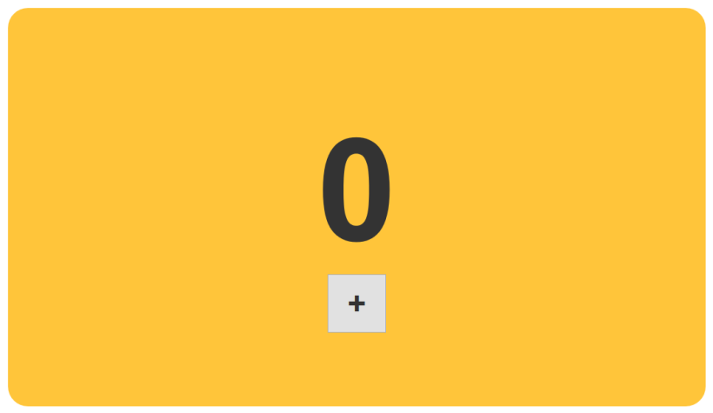
Event Use Case
...
class Counter extends React.Component {
...
return (
<div style={textStyle}>
{this.props.display}
</div>
);
...
class CounterParent extends React.Component {
getInitialState: function() {
return {
count: 0
};
},
...
return (
<div style={backgroundStyle}>
<Counter display={this.state.count} />
<button style={buttonStyle}>+</button>
</div>
...

Slide 46
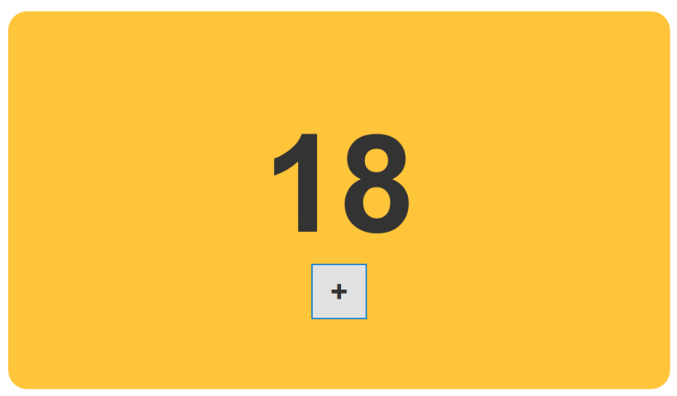
HTML Control Event
...
class CounterParent extends React.Component {
constructor(props) {
super(props);
this.state = {
count: 0
};
this.increase = this.increase.bind(this);
}
increase(e) {
this.setState({
count: this.state.count + 1
});
}
...
<Counter display={this.state.count} />
<button onClick={this.increase} style={buttonStyle}>+</button>
</div>
...

Slide 47
Synthetic Events
In React, when you specify an event in JSX like we did with onClick, you are not directly dealing with regular DOM events.
Instead, you are dealing with a React-specific event type known as a SyntheticEvent.
Each SyntheticEvent contains the following properties:
Property Name Type
bubbles boolean
cancelable boolean
currentTarget DOMEventTarget
A SyntheticEvent that wraps a MouseEvent will have access to mouse-specific properties such as the following:
boolean altKey
number button
number buttons

Slide 48
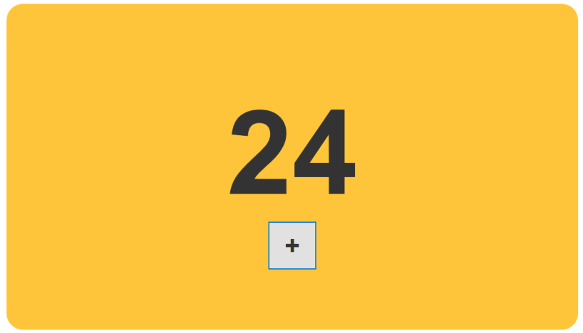
Event Properties
...
increase(e) {
var currentCount = this.state.count;
if (e.shiftKey) {
currentCount += 10;
} else {
currentCount += 1;
}
this.setState({
count: currentCount
});
}
...

Slide 49
DOM Events Note
Don't refer to traditional DOM event documentation when using Synthetic events and their properties.
Because the SyntheticEvent wraps your native DOM event, events and their properties may not map one-to-one. Some DOM events don't even exist in React.

Slide 50
Component Event
...
class PlusButton extends React.Component {
render() {
return (
<button onClick={this.props.clickHandler}>
+
</button>
);
}
}
class CounterParent extends React.Component {
...
return (
<div style={backgroundStyle}>
<Counter display={this.state.count} />
<PlusButton clickHandler={this.increase} />
</div>
...

Slide 51
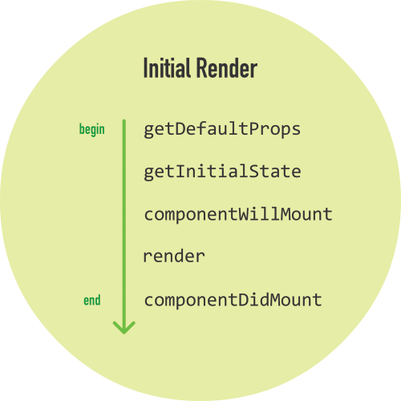
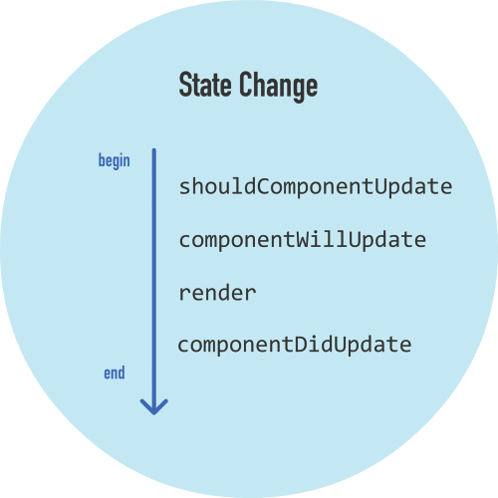
The Component Lifecycle (I)

Slide 52
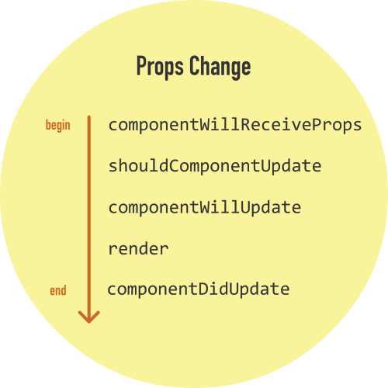
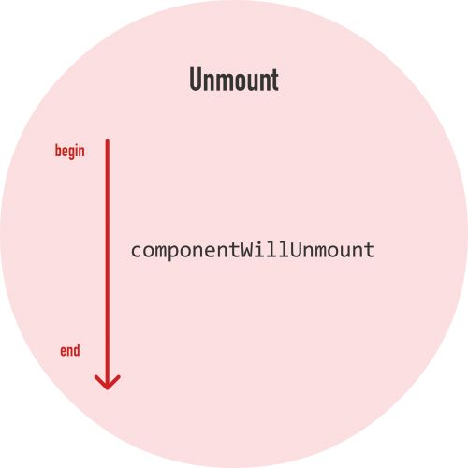
The Component Lifecycle (II)

Slide 53
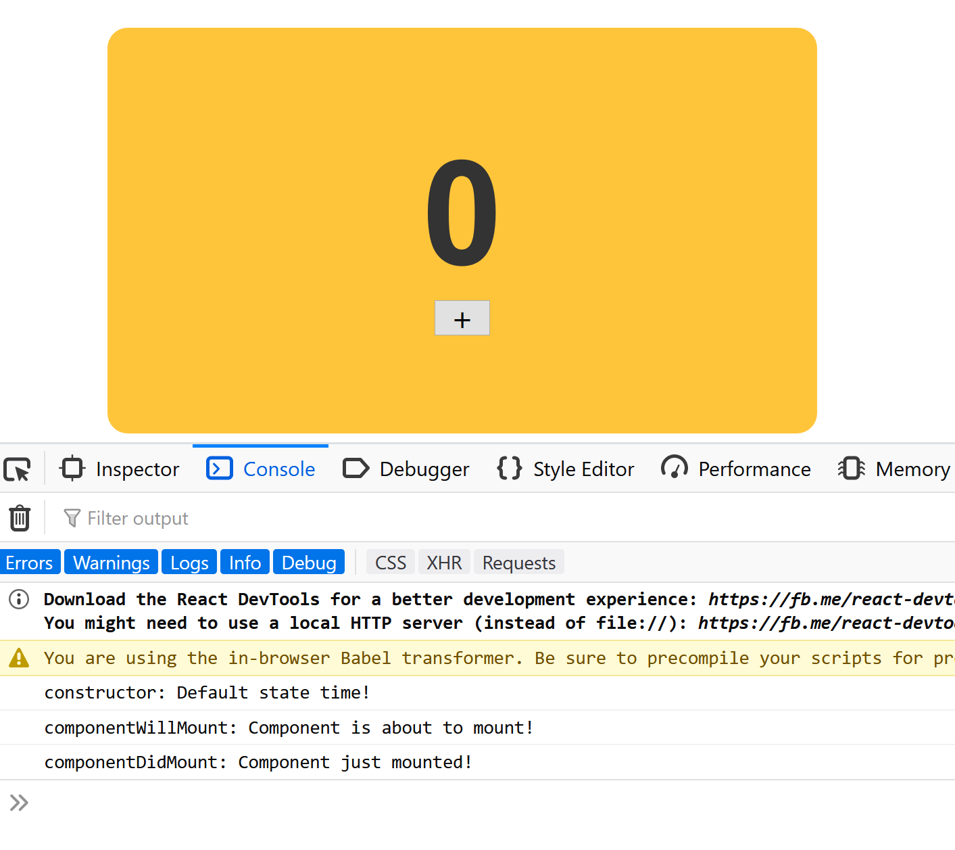
The Component Lifecycle (III)
...
class CounterParent extends React.Component {
constructor(props) {
super(props);
console.log("constructor: Default state time!");
this.state = {
count: 0
};
this.increase = this.increase.bind(this);
}
...
UNSAFE_componentWillUpdate(newProps, newState) {
console.log("componentWillUpdate: Component is about to update!");
}
componentDidUpdate(currentProps, currentState) {
console.log("componentDidUpdate: Component just updated!");
}
...

Slide 54

Thank You & See You Again

